Slide 1

Authors:
Diego Ávila, 903988
Laura Schiatti, 904738
Sukhpreet Virdi, 904204
TrackMe
Project presentation
Software Engineering II Project (A.Y. 2018/2019) – Politecnico di Milano

Slide 2
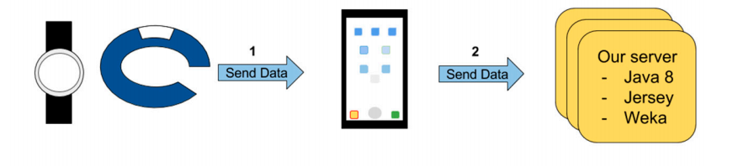
Problem and Scope
TrackMe develops health-monitoring devices devoted to measure and record different parameters related to the health status of a person (i.e. body temperature, blood pressure, heart pulse rate and percentage of O2 in the blood) and also their location.
TrackMe health smartwatch is synchronized with an app that gives users access to their data and stats.
Data4Help
AutomatedSOS
Track4Run
Our Server

Slide 3
World and shared phenomena
- Third-party customers willing to use the data acquired through the devices
- Health-care system
TrackMe wearable devices
Individuals sharing their personal data
The physical health parameters and location collected by the Trackme devices, and stored by Data4Help
Health-care system, that let AutomatedSOS send the alarms
- The running circuit defined in Track4Run
- The current location of the athletes participating in a run

Slide 4
Goals – Data4help
The individual can allow (or refuse) Data4Help to use their data.
The third-party company should be able to access data of a specific individual
The third-party company should be able to access anonymized data of groups of individuals under certain constraints.
The third-party company could subscribe to get new data related to specific Individuals or previously saved search.
G1
G2
G3
G4

Slide 5
Goals – AutomatedSOS/Track4Run
Provide a service capable to send a notification to the health-care service when
any individual’s parameter is out of range
Run organizers could define the path for a given run and TrackMe users can
enrol to it
Run spectators could track the position of all the runners during a race
G5
G6
G7

Slide 6
User characteristics
Individuals
Third-party companies
Users
Spectators
Organizers

Slide 7
TrackMe Model

Slide 8
Domain assumptions
[D6]
[D1]
Out of coverage scenarios cannot be handled by ASOS so as to guarantee a 5 seconds
reaction.
TrackMe guarantees that the wearables can provide sufficient accuracy and sensitivity
when monitoring individuals.
[D5]
[D2]
The provided SSN by the individual is valid and trustable.
TrackMe addresses data protection and integrity against possible attacks.
[D4]
[D3]
The data collected is directly related to the individuals' by their SSN and is
structured according to the data scheme required by D4H.
TrackMe devices are up and running during monitoring.

Slide 9
Functional requirements
Use case diagram for Data4Help

Slide 10
Use case for ASOS/Track4Run

Slide 11
Architecture

Slide 12
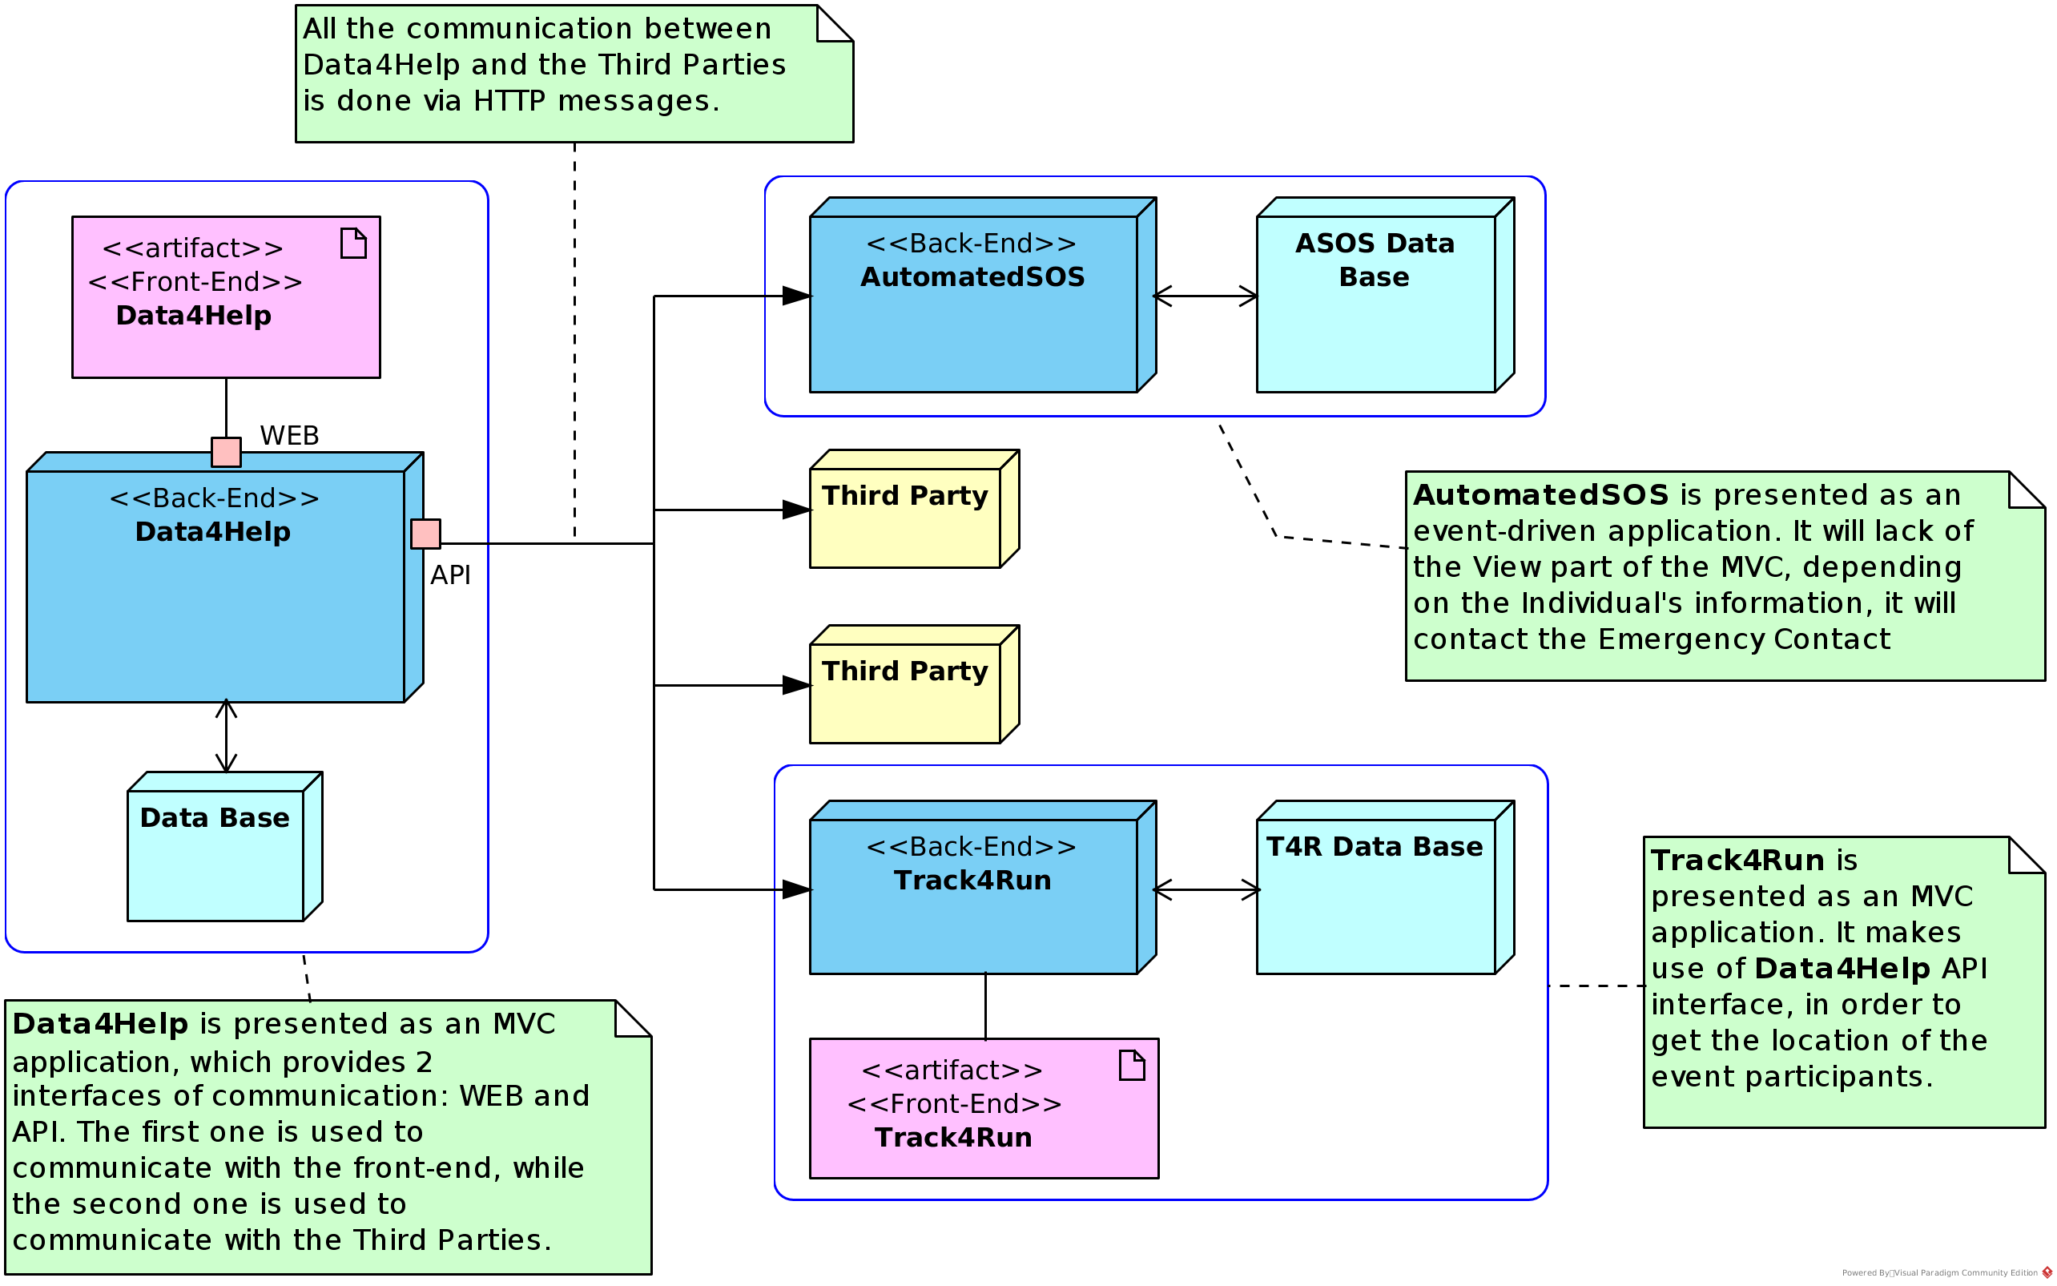
Overview

Slide 13
Overview
Data4Help and Track4Run have an MVC architecture in which they provide an interface to the web users.
AutomatedSOS does not provide any interface to the users.
Third parties communicate with Data4Help using HTTP messages, so they can send requests to specific individuals, or receive information about subscriptions.
AutomatedSOS can be presented as an event-driven application, which receives the Individuals’ information, and based on the defined thresholds it decides to contact the assigned emergency contact.

Slide 14
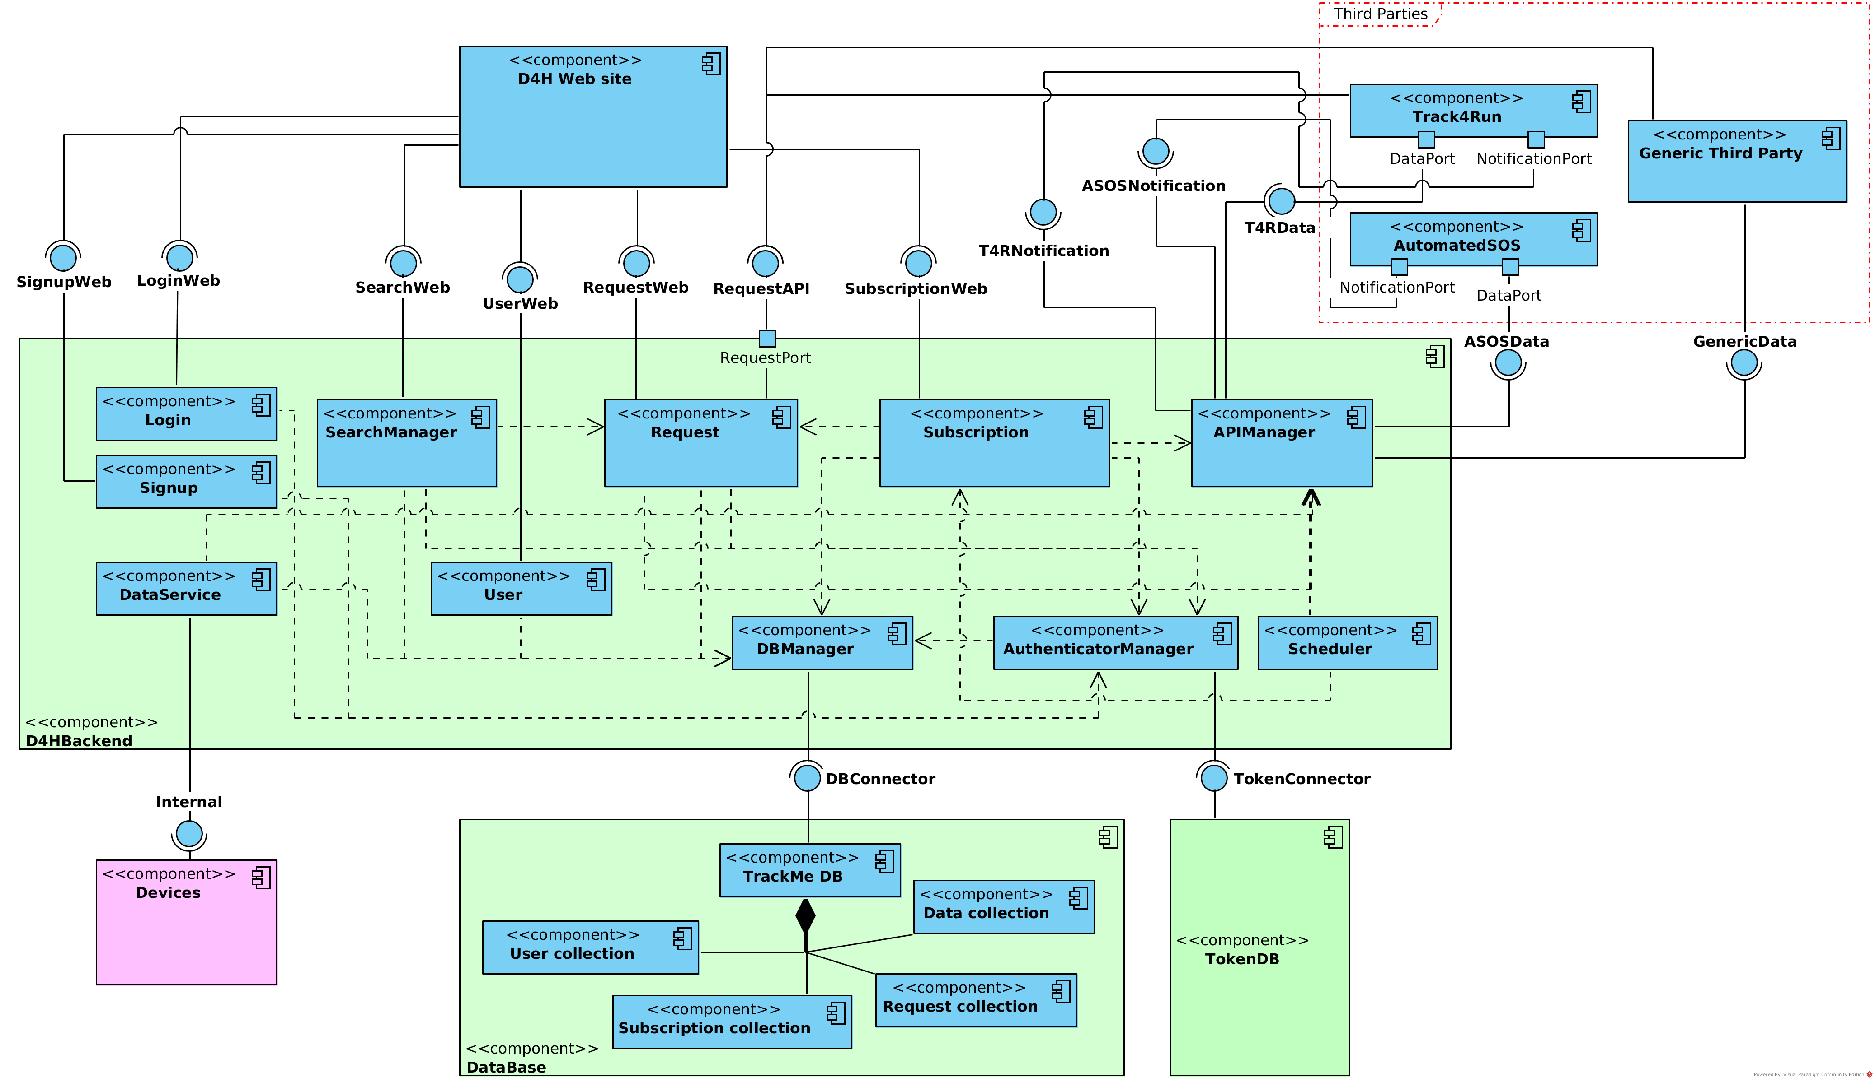
Components - Data4Help

Slide 15
Components - Data4Help
DataBase and D4HBackend: first one refers to the D4H database, which provides an interface used by the DBManager component; contains all the components related to D4H, which are needed to provide the interfaces used by the third parties and the web site.
Signup, Login, SearchManager, Request, User and Subscription, components provide interfaces used by the web site.
Request component provides an interface used by the third parties.
DataService component has the responsibility of get the data from the TrackMe smart devices, and store it in the data base.
Devices component makes reference to the smart-watches sold by TrackMe
Track4Run and AutomatedSOS are like third parties.

Slide 16
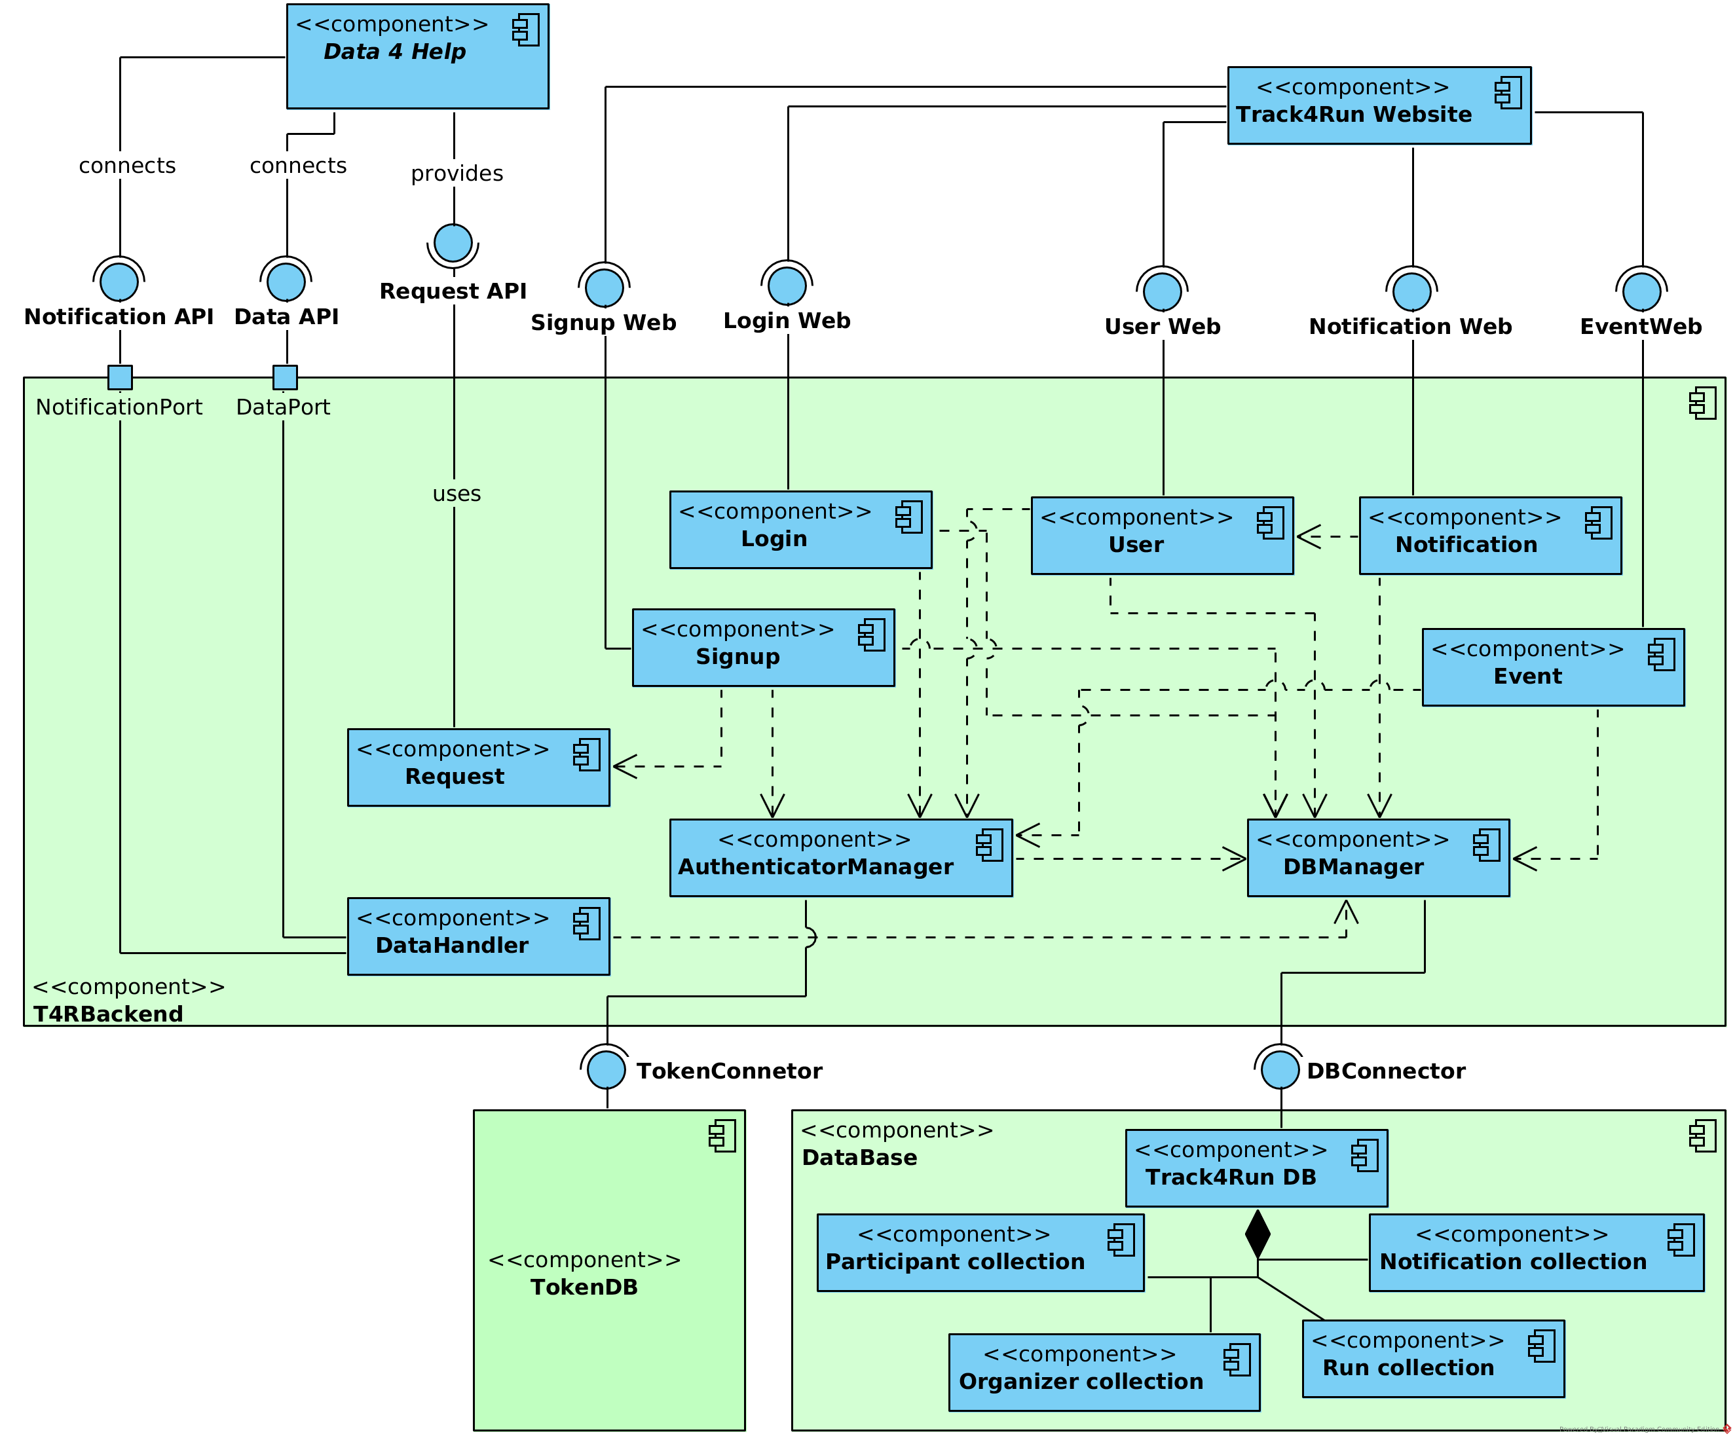
Components - Track4Run

Slide 17
Components - Track4Run
As in D4H, the main components are T4RBackend and DataBase.
Signup, Login, User, Notification, Event components provide interfaces to the web site.
Request component in this case, uses the interface provided by D4H in order to send requests to the Individuals.
DataHandler, is responsible of getting the data of the individuals and the notifications of accepted or rejected requests.

Slide 18
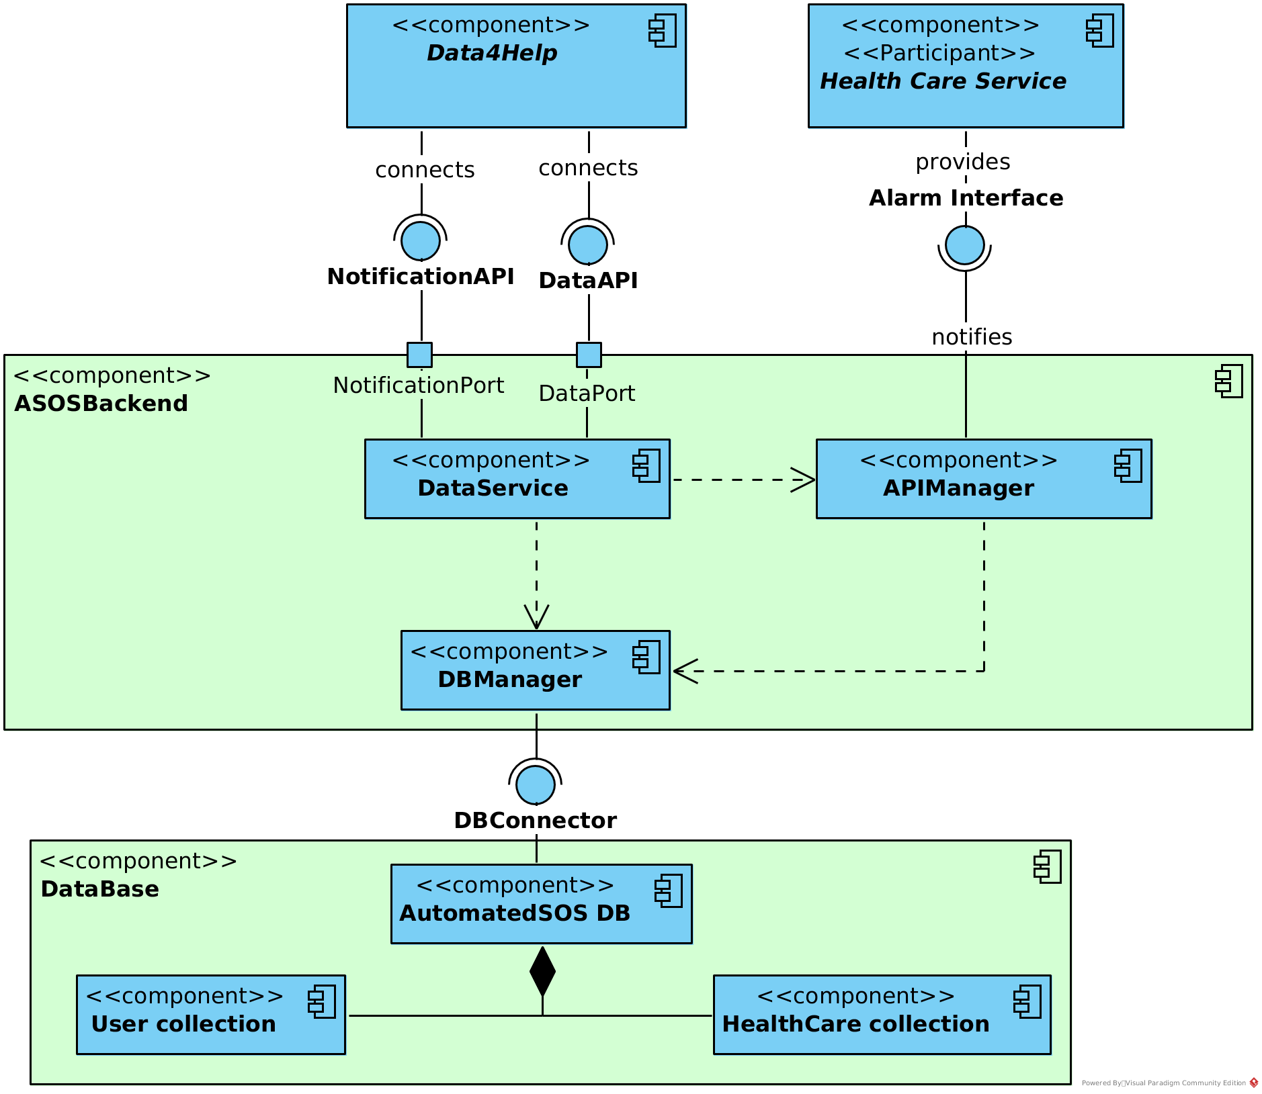
Components - AutomatedSOS

Slide 19
Components - AutomatedSOS
As in D4H and T4R, the main components are ASOSBackend and DataBase​.
DataService, is responsible of getting the data of the individuals and the notifications of accepted or rejected requests​.
APIManager is responsible of sending the notifications to the Health Care Service.

Slide 20
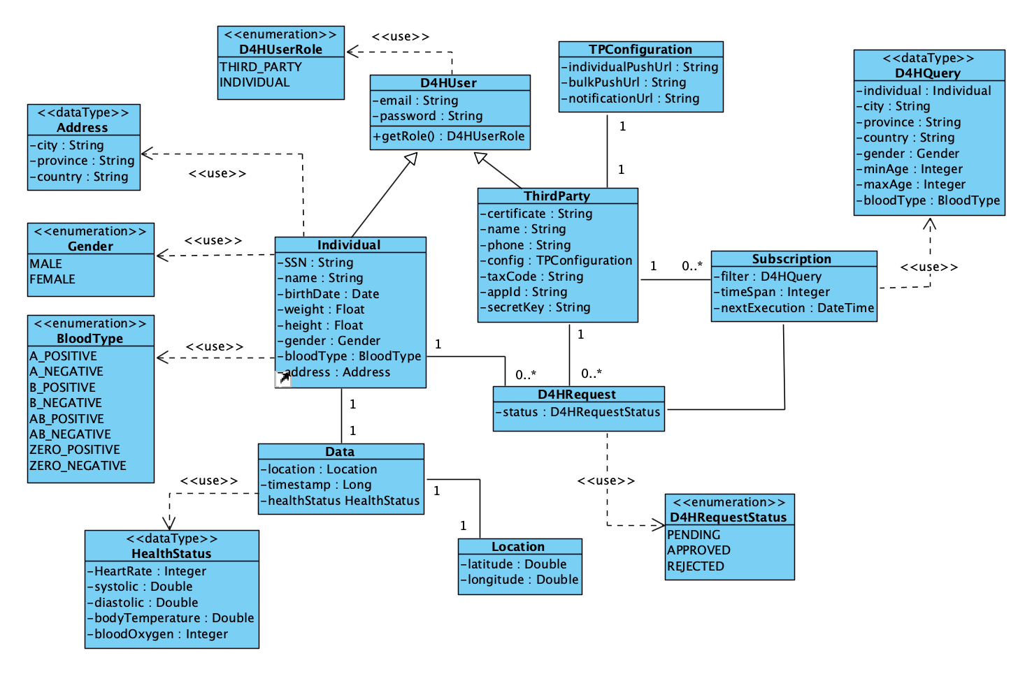
Data model - Data4Help

Slide 21
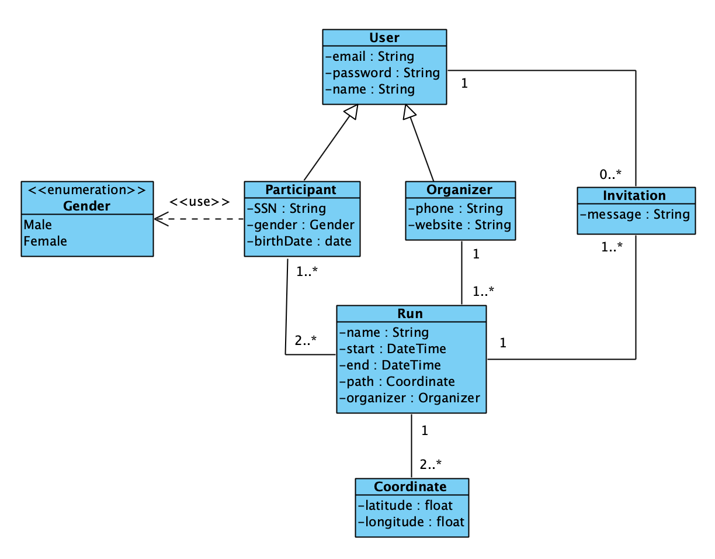
Data model - Track4Run

Slide 22
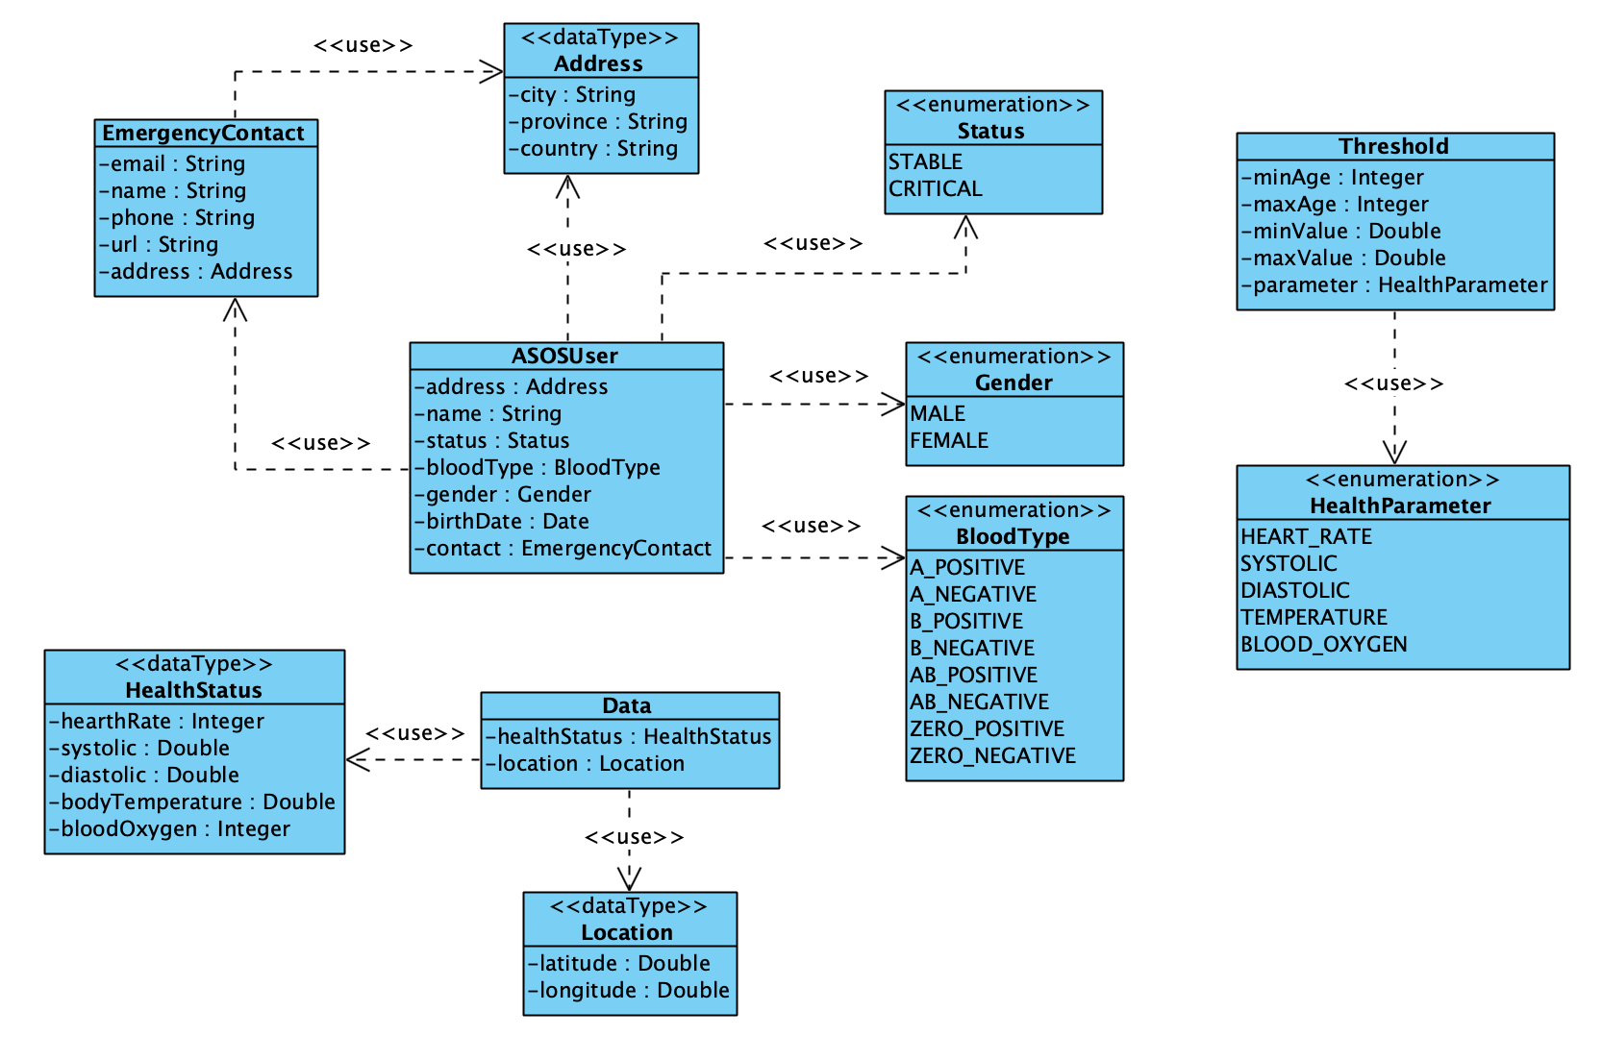
Data model - AutomatedSOS

Slide 23
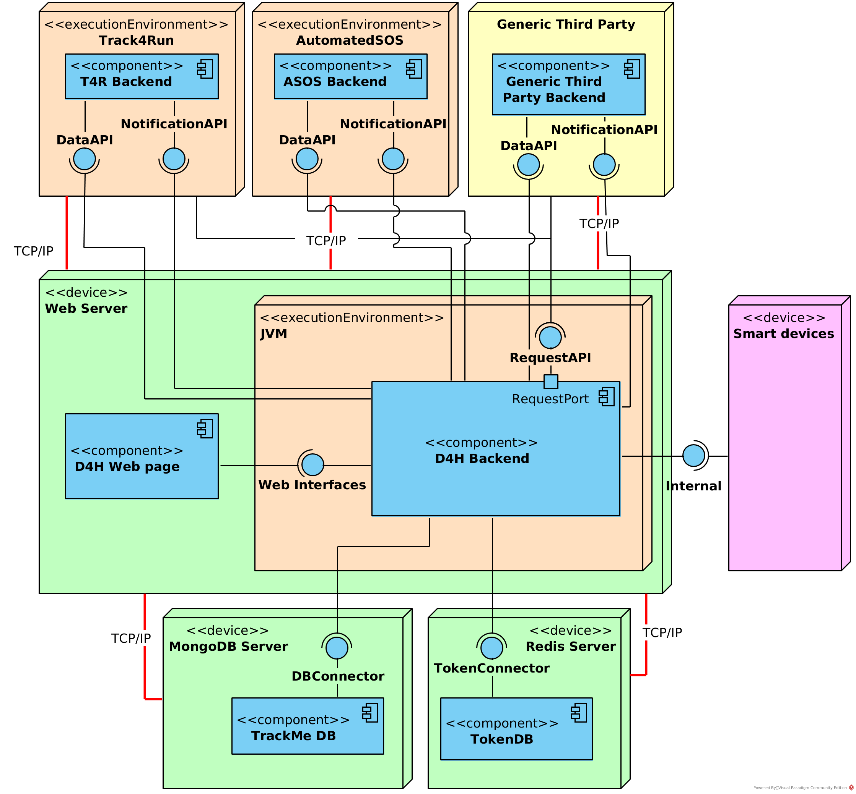
Deployment - Data4Help
Web Server node contains the web site and the backend (which runs in a Java environment)
Web Server communicates with the Smart Devices (through the Internal interface), with both Data Bases (through the TokenConnector and DBConnector) and with the Third Parties.
The individuals and third parties can interact with the system through the web site.
Here can be seen, again, that T4R and ASOS are treated as Third Parties.

Slide 24
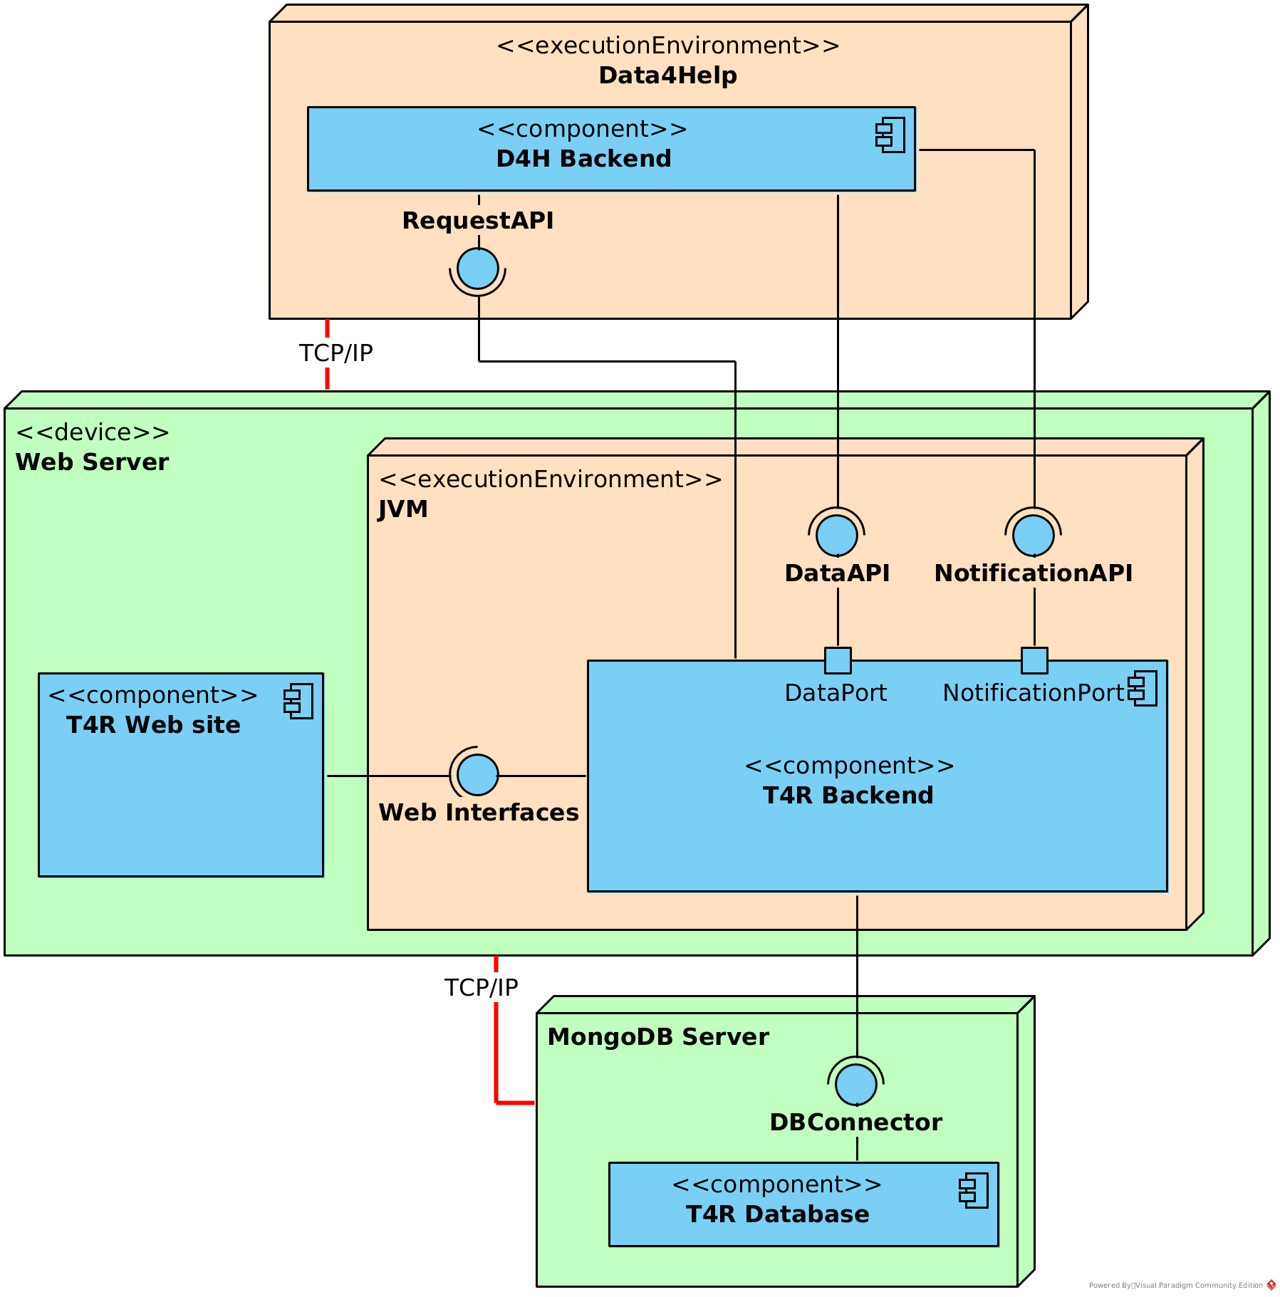
Deployment - Track4Run
Web Server node contains the web site and the backend (which runs in a Java environment)
Web Server communicates with the Data4Help, through the RequestAPI interface and the DataAPI and NotificationAPI.
Web Server connects to the MongoDB Server using the DBConnector.
The Individuals, Organizers and Spectators can interact with the system through the web site.

Slide 25
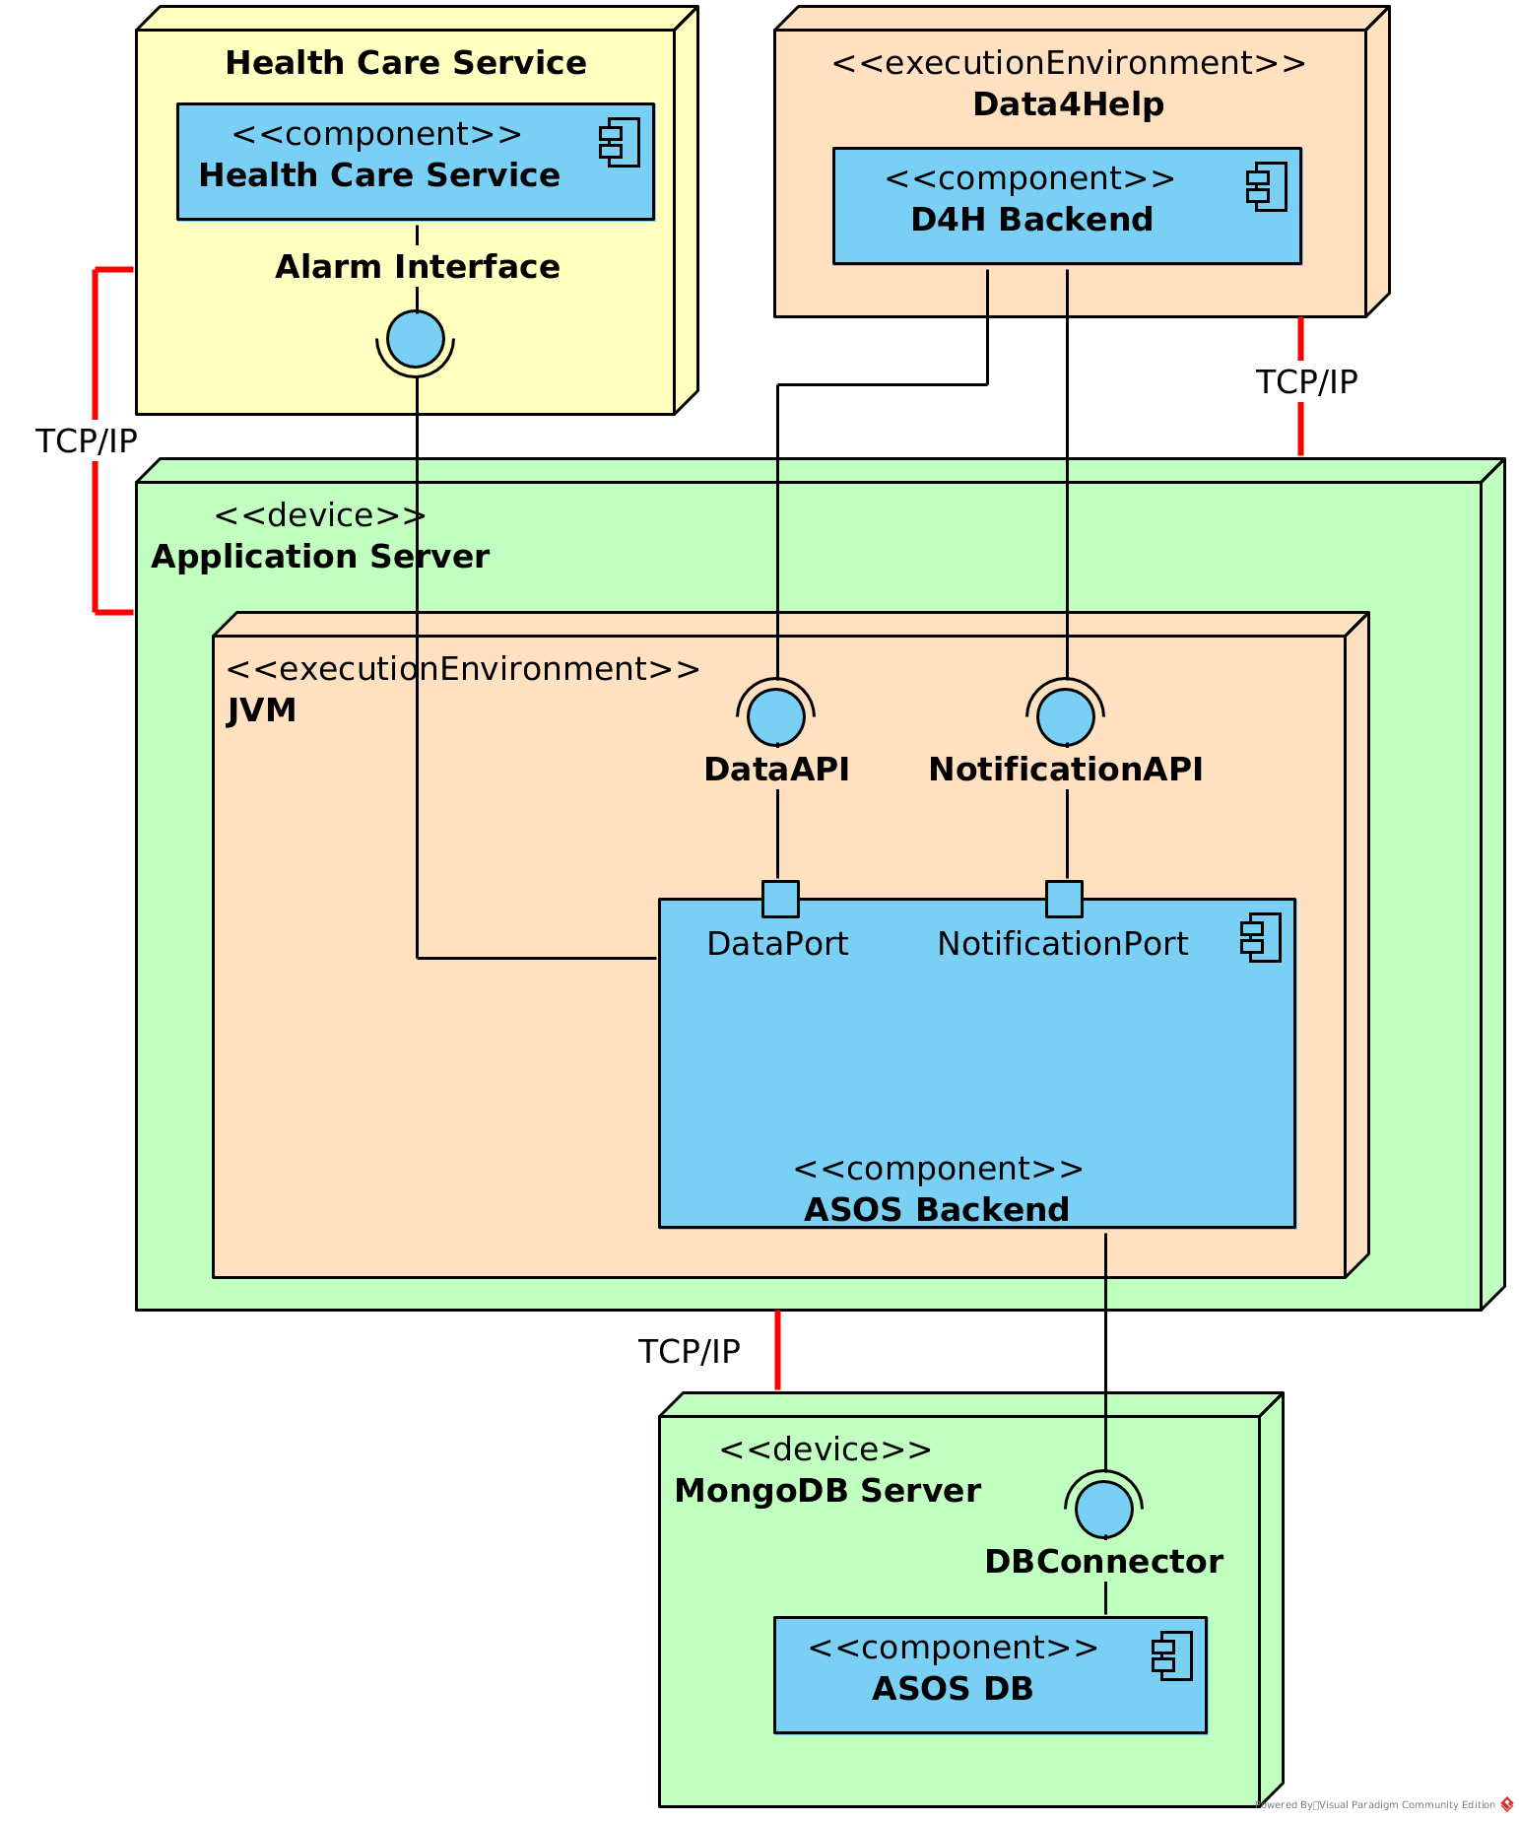
Deployment - AutomatedSOS
Application Server node contains the backend, which runs in a Java environment.
Application Server communicates with the Data4Help, through the DataAPI and NotificationAPI, and with the Health Care Service by using their Alarm Interface
Application Server connects to the MongoDB Server using the DBConnector.
There is no web site, hence the Individuals do not have access to the AutomatedSOS system, they can only interact by accepting or rejecting the requests.

Slide 26
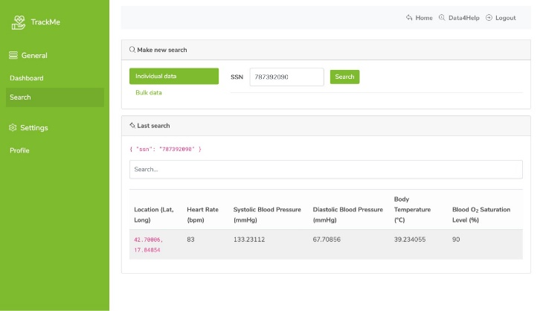
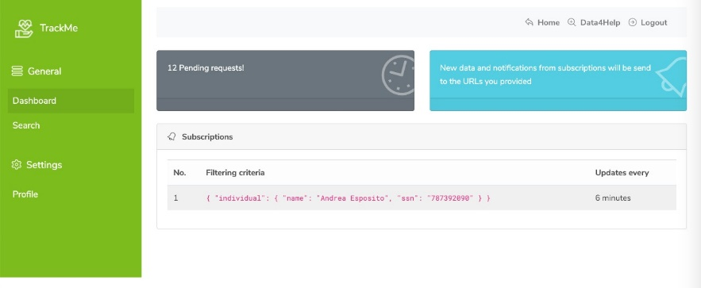
Implementation
Data4Help & AutomatedSOS

Slide 27
Implemented requirements?

Slide 28
Development frameworks

Slide 29
Integration & Testing
Data4Help & AutomatedSOS

Slide 30


Integration Strategy
Integration order:
Data4Help Components
Data4Help Web Site
DBManager, AuthenticationManager
LoginService and SignupService
RequestService, SubscriptionService
SearchManager, UserService, DataService
Schedulers
AutomatedSOS Components
DataService, DBManager
APIManager
Track4Run Components
Track4RunWebService
Track4RunDB
RunCollection
TokenService, OrganizerCollection and ParticipantCollection

Slide 31

System Integration Testing
Integration order of subsystems:
AuthenticationManager and LoginService
SearchManager, RequestService and SubscriptionService
DataService, DBManager and APIManager
RunCollection and ParticipantCollection
User Interaction Integration:
UserInterface and RequestService
UserInterface and NotificationService
UserInterface and RunCollection
UserInterface and HealthCareService External Resource

Slide 32
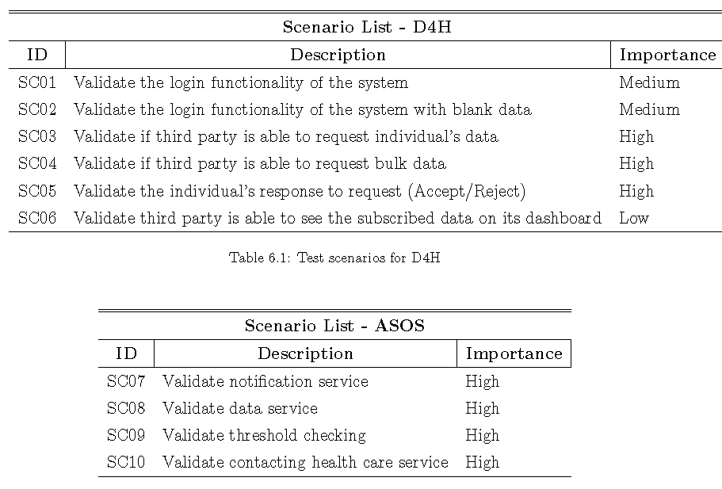
Test Plan

Slide 33
Fully Editable Icon Sets: A

Slide 34
Fully Editable Icon Sets: B

Slide 35
Fully Editable Icon Sets: C

